Slide 1
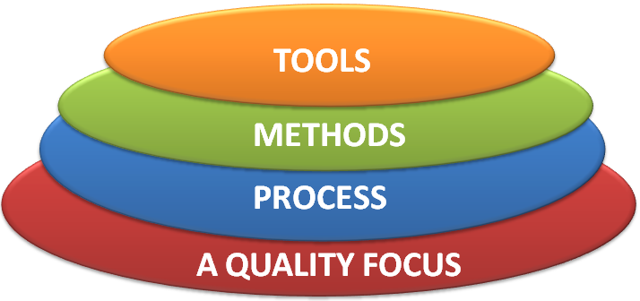
Week-1: Lesson-1 Software and Software Engineering

Slide 2

Discussion Topics
Appreciate Software Engineering
Nature of Software Engineering
Software Applications
Legacy of Software Engineering
Software Quality
Software Quality and Stakeholders
A Layered Technology
Software Process
Software Myths

Slide 3
What is Software?
Software is:
Instructions (computer programs) that when executed provide desired features, function, and performance;
Data structures that enable the programs to adequately manipulate information and
Documentation that describes the operation and use of the programs.

Slide 4

Characteristics/Nature of Software
Software is developed or engineered, it is not manufactured in the classical sense.
Software is intangible(unable to touch)
Hard to understand development effort
Software is easy to reproduce
Cost is in its development
The industry is labor-intensive
Hard to automate

Slide 5
Characteristics/Nature of Software
Untrained people can hack something together
Quality problems are hard to notice
Software is easy to modify
People make changes without fully understanding it
Software does not ‘wear out’
Relationship between failure rate and time.
the failure rate as a function of time for hardware

Slide 6
Characteristics/Nature of Software
Conclusions
Much software has poor design and is getting worse
We have to learn to ‘engineer’ software

Slide 7

Software Applications
System Software :
Operating system, drivers, networking software, telecommunications processors, Compilers.
Application Software:
Microsoft Office, Excel and Outlook, Google Chrome, Mozilla Firefox and Skype. Games and mobile applications such as "Clash of Clans," SoundCloud, Spotify and Uber, are also considered application software. Other specific examples include Steam, "Minecraft," Adobe Reader and Photoshop.
Engineering/scientific software:
Computer-aided Design and Computer-aided Manufacturing Software, Civil Engineering and Architectural Software , Electrical Engineering software, Geographic Information Systems Software, Simulation software, Interactive Software.
Embedded Software :
key pad control for a microwave oven, fuel control, dashboard displays, and braking systems, control and monitoring system.

Slide 8
Software Applications (Cont..)
Product-line software/Data Processing System:
Inventory control products, word processing, spreadsheets, computer graphics, multimedia, entertainment, database management, and personal and business financial applications
WebApps (Web applications)
Integrated with corporate databases and business applications: Booking application, Chatting application, Upload, E-Business, E-Commerce application.
AI software
Include robotics, expert systems, pattern recognition (image and voice), artificial neural networks, theorem, proving, and game playing.
Gaming Software
Mobile Device Software

Slide 9

Software—New Categories
Open world computing—pervasive/widespread, distributed computing
Ubiquitous computing—wireless networks(e.g. ccc, Smart lock, home automation, self driving)
Net sourcing—the Web as a computing engine.
Open source—”free” source code open to the computing community (a blessing, but also a potential curse!)

Slide 10
Legacy Software
Legacy implies that the software is out of date or in need of replacement, however it may be in good working order so the business or individual owner does not want to upgrade or update the software.

Slide 11
Legacy Software
Why must it change?
software must be adapted to meet the needs of new computing environments or technology.
software must be enhanced to implement new business requirements.
software must be extended to make it interoperable with other more modern systems or databases.
software must be re-architected to make it viable within a network environment.

Slide 12
Characteristics of WebApps
Network intensiveness. A WebApp resides on a network and must serve the needs of a diverse community of clients.
Concurrency. A large number of users may access the WebApp at one time.
Unpredictable load. The number of users of the WebApp may vary by orders of magnitude from day to day.
Performance. If a WebApp user must wait too long (for access, for server-side processing, for client-side formatting and display), he or she may decide to go elsewhere.
Availability. Although expectation of 100 percent availability is unreasonable, users of popular WebApps often demand access on a “24/7/365” basis.

Slide 13
Characteristics of WebApps(Cont…)
Data driven. The primary function of many WebApps is to use hypermedia to present text, graphics, audio, and video content to the end-user.
Content sensitive. The quality and aesthetic nature of content remains an important determinant of the quality of a WebApp.
Continuous evolution. Unlike conventional application software that evolves over a series of planned, chronologically-spaced releases, Web applications evolve continuously.
Immediacy. Although immediacy—the compelling need to get software to market quickly—is a characteristic of many application domains, WebApps often exhibit a time to market that can be a matter of a few days or weeks.
Security. Because WebApps are available via network access, it is difficult, if not impossible, to limit the population of end-users who may access the application.
Aesthetics. An undeniable part of the appeal of a WebApp is its look and feel.

Slide 14

Week-1: Lesson-2 Software and Software Engineering
Abdus Sattar
Assistant Professor
Department of Computer Science and Engineering
Daffodil International University
Email: abdus.cse@diu.edu.bd

Slide 15

Software Engineering
The IEEE definition:
Software Engineering:
The application of a systematic, disciplined, quantifiable approach to the development, operation, and maintenance of software; that is, the application of engineering to software.
IEEE-The Institute of Electrical and Electronics Engineers

Slide 16
Software Engineering (Cont..)
The process of solving customers’ problems by the systematic development and evolution of large, high-quality software systems within cost, time and other constraints

Slide 17
Software Engineering (Cont..)
Solving customers’ problems
The goal
Sometimes the solution is to buy, not build
Adding unnecessary features often makes software worse
Software engineers must communicate effectively to identify and understand the problem

Slide 18
Software Engineering (Cont..)
Systematic development and evolution
An engineering process involves applying well understood techniques in a organized and disciplined way
Many well-accepted practices have been formally standardized
e.g. by the IEEE or ISO
Most development work is evolution

Slide 19
Software Engineering (Cont..)
Large, high quality software systems
Software engineering techniques are needed because large systems cannot be completely understood by one person
Teamwork and co-ordination are required
Key challenge: Dividing up the work and ensuring that the parts of the system work properly together
The end-product must be of sufficient quality

Slide 20
Software Engineering (Cont..)
Cost, time and other constraints
Finite resources
The benefit must outweigh the cost
Others are competing to do the job cheaper and faster
Inaccurate estimates of cost and time have caused many project failures

Slide 21
Software Quality
Usability
Users can learn it and fast and get their job done easily
Efficiency
It doesn't’t waste resources such as CPU time and memory
Reliability
It does what it is required to do without failing
Maintainability
It can be easily changed
Reusability
Its parts can be used in other projects, so reprogramming is not needed

Slide 22
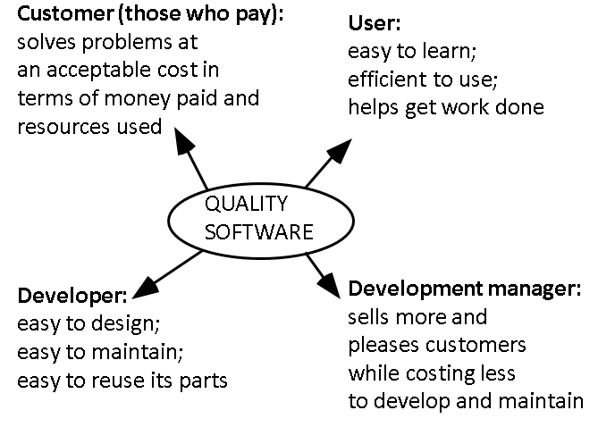
Software Quality and Stakeholders

Slide 23

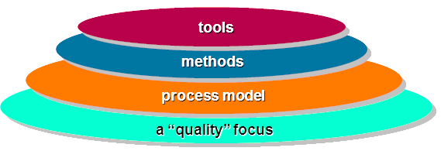
A Layered Technology
Fig: Software engineering layers

Slide 24
Software Process
A process is a collection of activities, actions, and tasks that are performed when some work product is to be created.
An activity strives to achieve a broad objective (e.g., communication with stakeholders) and is applied regardless of the application domain, size of the project, complexity of the effort, or degree of rigor with which software engineering is to be applied.
An action (e.g., architectural design) encompasses a set of tasks that produce a major work product (e.g., an architectural design model).
A task focuses on a small, but well-defined objective (e.g., conducting a unit test) that produces a tangible outcome.

Slide 25
The Essence of Practice
George Polya outlined The essence of software engineering practice:
Understand the problem (communication and analysis).
Plan a solution (modeling and software design).
Carry out the plan (code generation).
Examine the result for accuracy (testing and quality assurance).

Slide 26
Software Myths
Pressman describes a number of common beliefs or myths that software managers, customers, and developers believe falsely.
He describes these myths as ``misleading attitudes that have caused serious problems.'' We look at these myths to see why they are false, and why they lead to trouble.
Affect managers, customers (and other non-technical stakeholders) and practitioners
Are believable because they often have elements of truth,
but …
Invariably lead to bad decisions,
therefore …
Insist on reality as you navigate your way through software engineering

Slide 27
Hooker’s General Principles
1: The Reason It All Exists
2: KISS (Keep It Simple, Stupid!)
3: Maintain the Vision
4: What You Produce, Others Will Consume
5: Be Open to the Future
6: Plan Ahead for Reuse
7: Think!

Slide 28
References:
1. Software Engineering by Ian Sommerville,
9th edition, Addison-Wesley, 2011
2. Software Engineering A practitioner’s Approach by Roger S. Pressman, 7th edition, McGraw Hill, 2010.

